Slide 1
CHINOOK MUSIC STORE ANALYSIS
BY
Dhruv Kanther

Slide 2
Agenda
Problem Statement
Data Description
Objective Key Metrics and Visualizations
Subjective Question for Insights

Slide 3
Problem Statement
Chinook aims to derive actionable insights from its sales data to better understand customer purchasing behavior and market trends within the music industry. The primary objectives include:
Identifying top-selling tracks and artists
Analyzing customer demographics and purchasing trends
Evaluating genre performance and regional preferences
This analysis will support the development of targeted marketing campaigns, improve customer retention strategies, and guide promotional efforts for upcoming releases—especially those tied to specific genres or geographic markets.
Furthermore, Chinook seeks to build predictive models for customer segmentation, enabling the identification of at-risk customers and enhancing customer lifetime value forecasting. These insights will inform data-driven decisions across marketing, sales, and product development teams.

Slide 4
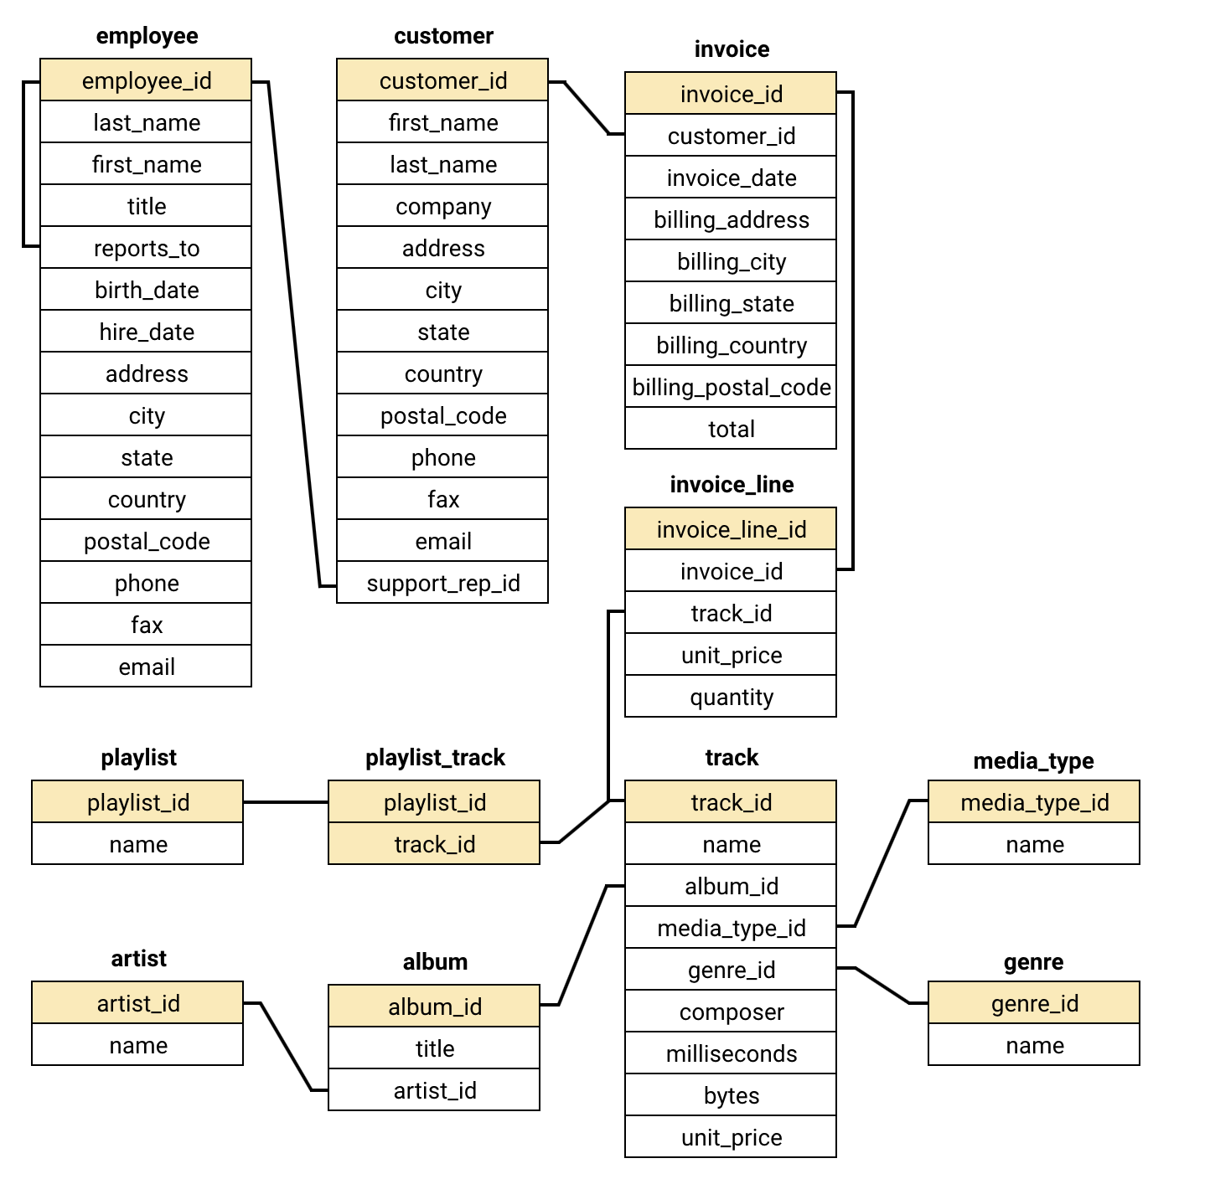
Database Schema

Slide 5
DATA DESCRIPTION

Slide 6
Data Description
customer:
customer_id: Unique identifier assigned to each customer.
first_name: The given name or first name of a customer.
last_name: The surname or family name of a customer.
company: The name of the company associated with a customer.
address: The street address of a customer's location.
city: The city where a customer is located.
state: The state or province where a customer is located.
country: The country where a customer is located.
postal_code: The postal or zip code of a customer's address.
phone: The phone number of a customer.
fax: The fax number associated with a customer.
email: The email address of a customer.
support_rep_id: The employee ID of the support representative assigned to a customer.

Slide 7
Data Description
invoice_line:
invoice_line_id: Unique identifier assigned to each line item on an invoice.
invoice_id: The invoice ID to which the line item belongs.
track_id: The ID of the track or product included in the line item.
unit_price: The price per unit for the line item.
quantity: The quantity of units for the line item.
invoice:
invoice_id: Unique identifier assigned to each invoice.
customer_id: The customer ID associated with the invoice.
invoice_date: The date when the invoice was generated or issued.
billing_address: The street address used for billing purposes.
billing_city: The city used for billing purposes.
billing_state: The state or province used for billing purposes.
billing_country: The country used for billing purposes.
billing_postal_code: The postal or zip code used for billing purposes.
total: The total amount due on the invoice.

Slide 8
Data Description
playlist:
playlist_id: Unique identifier assigned to each playlist.
name: The name or title of the playlist.
playlist_track:
playlist_id: The ID of the playlist to which the track belongs.
track_id: The ID of the track included in the playlist.
genre:
genre_id: Unique identifier assigned to each genre.
name: The name or description of the genre (e.g., rock, pop, classical).
artist:
artist_id: Unique identifier assigned to each artist.
name: The name of the artist.

Slide 9
Data Description
track:
track_id: Unique identifier assigned to each track or song.
name: The title or name of the track.
album_id: The ID of the album to which the track belongs.
media_type_id: The ID of the media type associated with the track.
genre_id: The ID of the genre associated with the track.
composer: The name of the composer or artist who composed the track.
milliseconds: The duration of the track in milliseconds.
bytes: The file size of the track in bytes.
unit_price: The price per unit for the track.
album:
album_id: Unique identifier assigned to each album.
title: The title or name of the album.
artist_id: The ID of the artist associated with the album.
media_type:
media_type_id: Unique identifier assigned to each media type.
name: The name or description of the media type (e.g., MPEG audio file, AAC audio file).

Slide 10
OBJECTIVE KEY METRICS AND VISUALIZATIONS

Slide 11
Demographic Distribution
This slide provides an overview of the customers distributed across different geographic locations.
USA has the highest number of customers in the list followed by Canada, Brazil, France, Germany and UK.
Other countries like India, Portugal, Argentina, Australia , Austria, Belgium, etc. have only 1 or 2 customers.

Slide 12
Revenue Across Countries
The chart shows us the revenue based on the track sales in all the countries.
For better visualization, we have considered the top 10 countries in terms of revenue.
The highest sale is in USA with an amount of 1040.49 and 131 purchases, followed by Canada and Brazil in the 2nd and 3rd places respectively.
This visualization helps us to focus on the sales based on the geographic location.

Slide 13
Top-Selling Tracks
The visual displays the top 10 selling tracks in USA which conveys the following:
War Pigs is the highest selling track in USA generating a revenue of 58.41 followed by Scentless Apprentice with a revenue of 44.55.
This information helps in understanding the customer preferences of the tracks based on the purchase.

Slide 14
Top-Selling Artists
The visual depicts the top selling artists in USA from the given data. We can infer the following from the visual as follows:
Van Helen is the top selling artist in USA with a revenue of 525.69 followed by Eric Clapton.
This data can help us identify the top artists related to the tracks and genre and also recommend them to the customers who have similar preferences.

Slide 15
Famous Genres - (Count of Tracks Sold)
We can observe the top 5 genres in USA with respect to the number of tracks sold.
The Rock genre has the most number of tracks sold (516), followed by Alternative & Punk and Metal.
This visual helps us to understand the customer’s preferences on genres with which we can recommend similar genres to the customer for future purchases.

Slide 16
Famous Genres in USA in terms of Revenue
The chart besides displays the top 5 genres in USA with regard to the revenue generated in terms of sales.
The Rock genre has generated the most revenue in USA, followed by Alternative & Punk and Metal.
This visual helps us to identify the best selling genre and the customer’s music preferences so that recommendations can be done for future purchases.

Slide 17
Top Selling Tracks for customers
The chart displays the top-10 customers with maximum amount spent on a track.
Since there are more customers, we have considered the top 10 customers based on the total sales.
The customer named Wyatt Girard has made the highest purchase of 23.76 for a single track.
This chart helps us to get an insight of how much revenue has been generated through the purchases made by various customers.

Slide 18
Purchase Frequency
The visual displays the purchase frequency of customers which is the average amount of days difference that a customer takes to do a new purchase.
Since there are more customers, we have considered the top 20 customers based on the average days between their purchases
In this case, František Wichterlová makes a purchase on an average of every 74 days which is better compared to the customers who places an order every 121 and many more days in average.
This helps us to determine which customers are active and the customers that are inactive for quite a period of time.

Slide 19
Tracks and Genre Count of each Customer
The visual besides shows us the tracks purchased by the customers. It also shows the count of genres associated to those tracks purchased.
For example, the customer named Leonie Köhler has purchased 83 tracks from 14 different genres which shows a diversity in the purchase made by Leonie Köhler.

Slide 20
Customer Churn Rate
A customer is considered to be a churned customer if they have made any purchase in the last year but not in the current year.
Total Number of customers = 59
The customer churn rate implies that a customers are not churned at a very rapid rate.
Year 2020 (which have churned customers -4) implies that instead of losing customers, they have gained customers.

Slide 21
SUBJECTIVE ANALYSIS

Slide 22
Recommendations based on Genre Sales Analysis in USA
Based on the Genre Sales Analysis, the following 3 albums can be prioritised for advertising and promotion in USA:
Seek And Shall Find: More Of The Best (1963-1981) – R&B Soul
From The Muddy Banks Of The Wishkah [live] - Rock
House of Pain – Hip/Hop Rap

Slide 23
Famous Genres in countries other than USA
"Rock" is overwhelmingly the most popular genre globally (excluding the USA).
Indicates a strong global preference for rock music, suggesting it has broad international appeal.

Slide 24
Customer Purchasing Behaviour
This graph help us to understand the purchasing pattern of the customers.
The orange bar specifies the purchasing behaviour of short-term customers and the blue bar represents the purchasing behaviour of long term customers.
Long-Term Customers are those who are purchasing even after 1100 days.
Long-Term customers more often, buy more per order, and spend more.
Their total lifetime value (LTV) is ~34% higher than that of short-term customers.

Slide 25
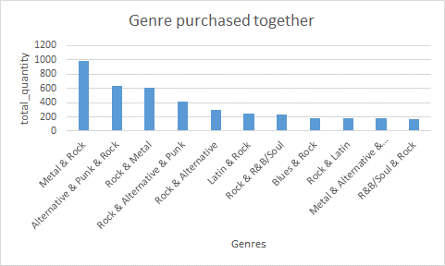
Product Affinity Analysis
We have created combinations of genres where the track_id are same. It might appear, for e.g. Rock and metal and Meta and are same but no, they are from different tracks, that’s why there are multiple records.
Common Genres:
Rock acts as a central genre — most genres are paired with it
Product Recommendations:
Suggesting related genres (such as Alternative) or introducing musicians inside Rock and Metal may work well for clients like Frank who buy a lot of this genre.
Cross-Selling Initiatives:
Since rock, metal, and alternative and punk music are always in style, make customized playlists for every client that feature their best songs.

Slide 26
Regional Market Analysis
Based on the customer average spend, average orders, total spend and total orders, the regional market analysis is performed which gives the following insights:
The customers are classified into 3 categories: Low Risk, High Risk and Medium Risk.
Customers from USA, Canada, Brazil, etc are contributing to high revenue even after less average order per customer than Chile, Ireland etc.

Slide 27
CLV Modeling : Customer Tenure
This chart shows us about the total number of orders and how much average number of days a customer took to place a order.
Top-5 customers placed more orders and the average days between orders are also less as compared to bottom 5 customers.
Customers with recent inactivity could be sent targeted re-engagement emails with discounts or exclusive offers.

Slide 28
Customer Purchasing Behavior
The visual illustrates the average tracks purchased by each customer in each country from the given data.
We can observe that Czech Republic has the highest average tracks purchased (138) per customer followed by Ireland (115).
This data provides us an idea of the customer distribution across the geographic locations and the purchasing pattern of customers in these locations.

Slide 29
Customer Purchasing Behavior Analysis
The visual illustrates the average revenue by each customer in each country from the given data.
We can observe that Czech Republic has the highest average amount spent (1591.92) per customer followed by Ireland (1433.52).
This data provides us an idea of the customer distribution across the geographic locations and the purchasing pattern of customers in these locations.

Slide 30
CONCLUSION

Slide 31
Conclusion
To conclude, the analysis done in this presentation provides insights into customer purchasing behavior and preferences based on geographic location and genre popularity, enabling targeted recommendations.
By identifying high-revenue customers and tracking purchase frequency, companies can develop strategies to re-engage inactive customers and prevent churn in high-risk segments.
The data also highlights the popularity of specific genres like Rock across locations, which can inform cross-selling and upselling opportunities tailored to regional and customer preferences.
Furthermore, differences in purchasing patterns between long-term and new customers reveal opportunities for loyalty programs and targeted offers to boost retention and customer satisfaction.

Slide 32
Acknowledgements and References

Slide 33
Acknowledgements and References
This project and the accompanying analysis were conducted independently as part of my academic coursework.
I would like to express my sincere gratitude to Asif Iqbal for their invaluable guidance in SQL and Newton School for all the support and insights provided through the course materials, which played a crucial role in shaping this work.
Thank You

